Slide 1
Abdullah Alkayali
Final Project Draft

Slide 2






Dooly’s DOMAIN
HOME ABOUT SERVICES CONTACT
ABDULLAH
ALKAYALI
IT Specialist ● Web Dev ● Tutor

Slide 3

Dooly’s DOMAIN
HOME ABOUT SERVICES CONTACT
I HELP PEOPLE ADVANCE
Computer Information Technology enthusiast who is passionate about technology with a strong background in customer service and teamwork. Motivated to provide people with IT solutions that improves business and personal success.
C++, Java Programming Languages JavaScript, CSS, HTML, Regular Expressions Linux and Windows system administration AWS, Azure system administration | Microsoft Office Software engineering fundamentals & software design models (UML) Database management systems (MySQL, MS SQL)

Slide 4

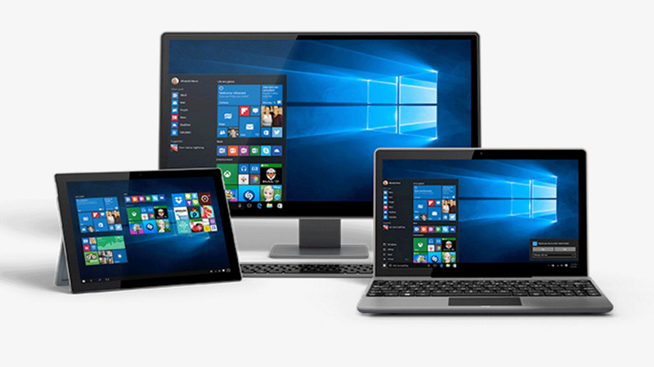

Dooly’s DOMAIN
HOME ABOUT SERVICES CONTACT
IT solutions that take the
Customer to the next level
Get help designing
your website!
Repair & Upgrade &
Configure your machine!
Learn new technical skills!
Web Development
Computer Maintenance
Tutoring

Slide 5
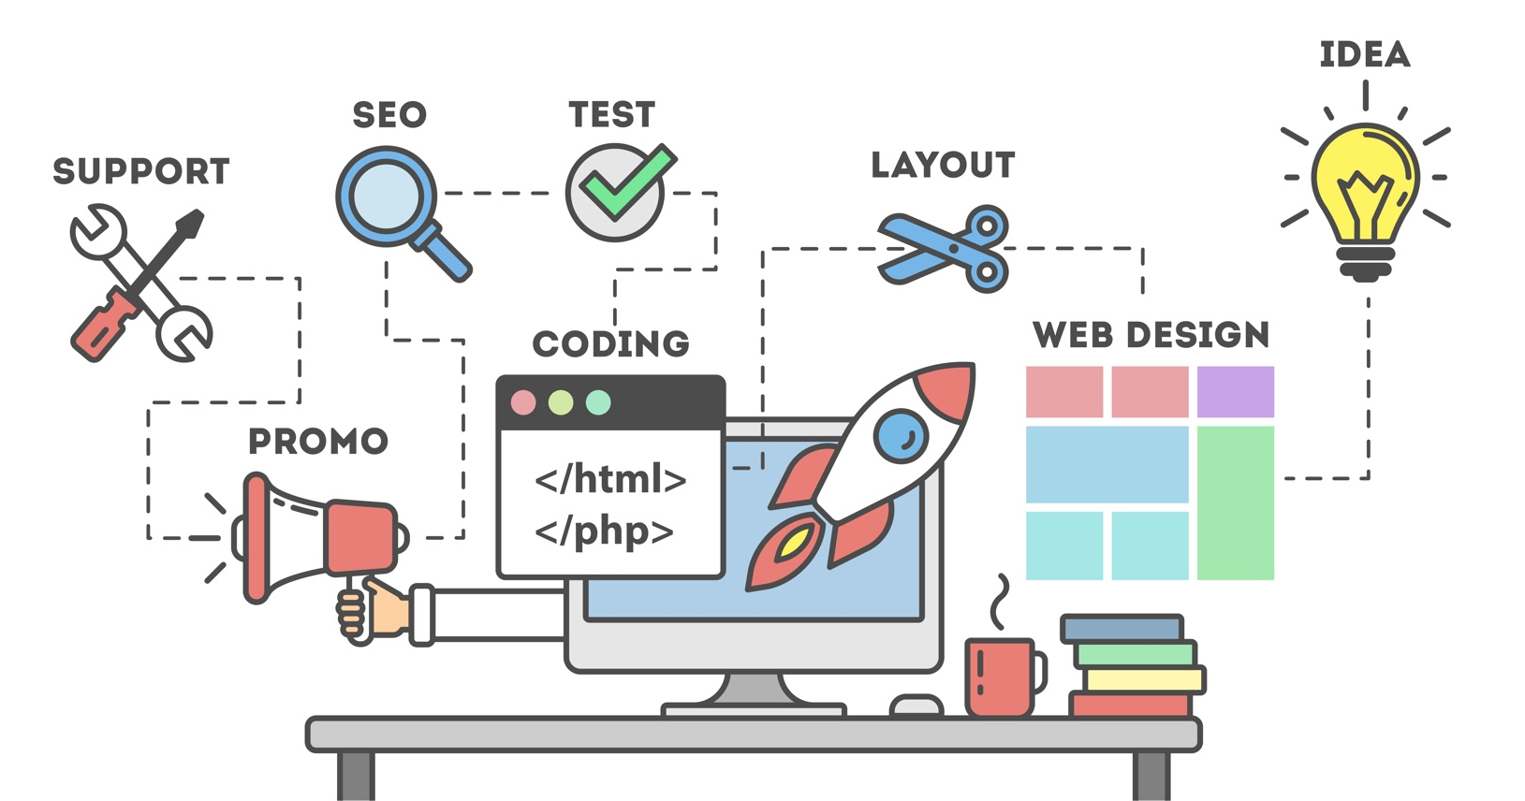
Dooly’s DOMAIN
HOME ABOUT SERVICES CONTACT
Subscribe to our newsletter and receive updates
about trending technology and our latest projects!
Email Address
Subscribe

Slide 6
Website Guidelines
Display all of the website’s page labels on every page for easy navigation
Included clear explanations/one word labels and simple vocabulary to describe the functionality.
Used big text on the website for older people & people with vision impairment to be able to read easily
Text is resizable to fit the users need without losing the design format

Slide 7
Website Guidelines
Used pictures to help the user recognize the content rather than recall
Make website visually appealing to capture the users attention
Used hierarchical structure to organize the content
Each Label is described to fit the users goals and where they need to check out

Slide 8
Website Guidelines
Used a familiar website layout and design for predictability and familiarity
The website is targeted for a few groups:
Business owners that want to improve technicality
College students or people that need help learning new technical skills
People that need their machine repaired/upgraded/configured

